Slide 1
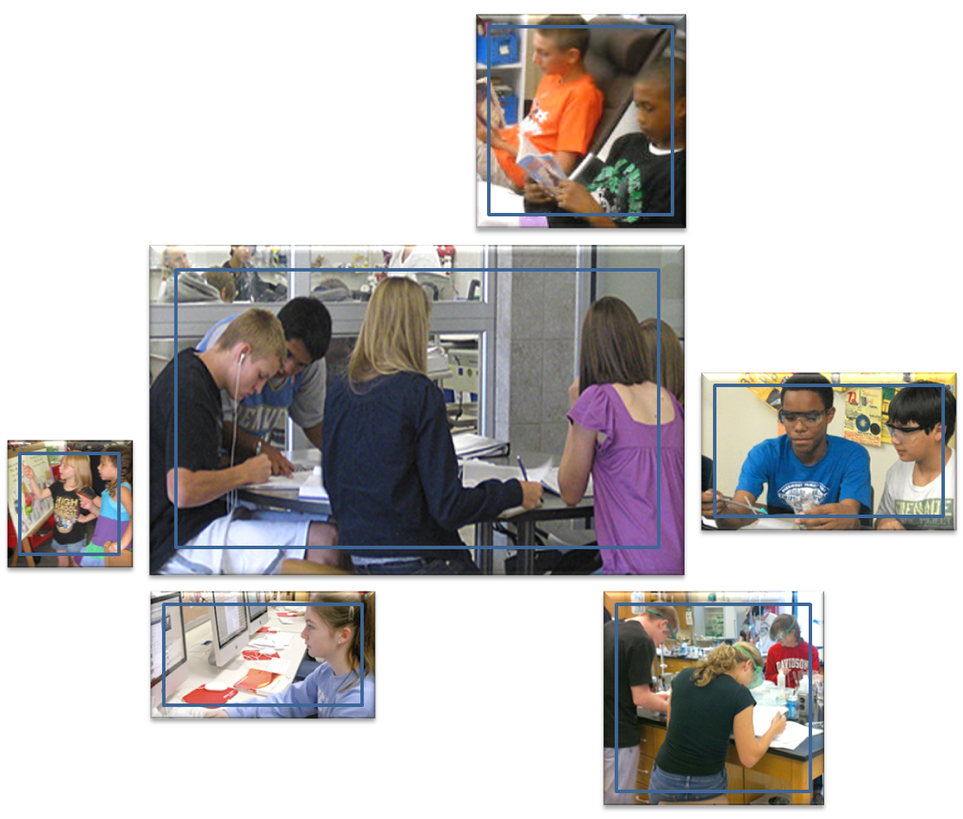
Contemporary Design for
21st Century Learning
Board Work Session
October 25, 2012

Slide 2
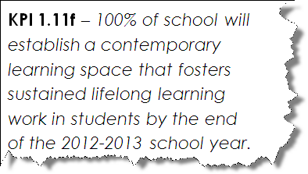
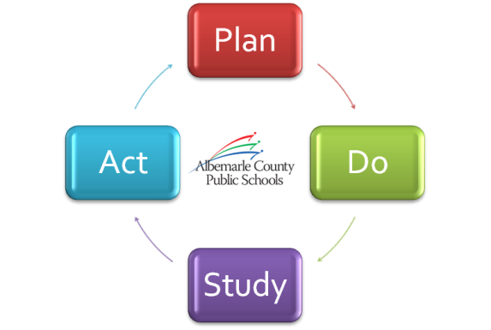
Goal 1 Focus
Lifelong Learning
Learning Spaces

Slide 3
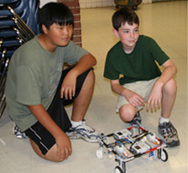
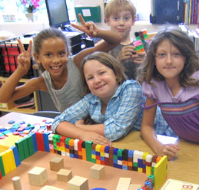
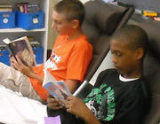
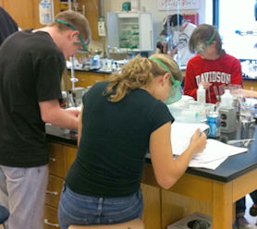
Purpose
See and hear about examples of learning spaces and tools in our schools that promote optimal learning

Slide 4
Format
Overview
Breakout Sessions
Reconvene and Board Debrief
Concluding Remarks

Slide 5
Meeting Planner
6:50pm to 7:20pm: Overview Presentation
7:20pm to 7:30pm: Transition to Breakout
Rooms (241, 246, 320)
7:30pm to 8:10pm: Breakout Sessions
8:10pm to 8:20pm: Reconvene
8:20pm to 8:40pm: Board Debrief
8:40pm to 8:50pm: Closing Remarks

Slide 6

OUR VISION
All learners believe in their power to embrace learning, to excel, and to own their future.
OUR MISSION
The core purpose of Albemarle County Public Schools is to establish a community of learners and learning, through relationships, relevance, and rigor, one student at a time.
Grand Challenge
“To educate ALL students with 21st Century learning skills by providing quality learning experiences in EVERY classroom.”
Notes:
As we begin this work session on 21st Century Learning, I believe it is appropriate to start at the beginning and review the divisions vision and mission. I know as we have been having this discussion with staff and administrators this fall, these vision and mission statements take on a deeper meaning. As we talk about personalized learning and student choice, choices of learning spaces and tools, engaging, relative curriculum, the idea of learners having the power to embrace learning, to excel and own their own future starts to become more real and viable. At the k – 12 principal meeting on Tuesday, we heard from Dr. Kathy Thorton, a former astronaut. One of the most powerful statements I heard her make was that we talk about preparing students for their future in the 21st century, that is not possible, because the world is moving so quickly that we don’t really know what the 21st century holds in store for us or students. What we are doing is teaching students to be prepared for the 21st century, so that they can handle whatever challenges they may face. So, this becomes our Grand Challenge. The question I would ask the board to think about tonight is “Who is this learning for?” Since 2002 and the beginning of our Design 2004 challenge, the division has been very deliberate with our research and development work. We have supported small scale projects through our inventors – our teachers who have wanted and are ready to move from low earth orbits to deeper space exploration. We want to move this level of work and student opportunities to all schools and all classrooms.

Slide 7
Framework for Quality Learning
21st Century Learning
Blending the traditional 3 R’s and the more contemporary 4 C’s
3 R’s + 4 C’s = Lifelong-Learner Standards
http://www.youtube.com/watch?v=JLNumJEWOtg&feature=plcp
Notes:
EdLeader21 – 21st Century Learning: MESA You tube video from MESA students. These students were given an assignment to create an electric guitar and speaker from scratch and then write a song and play using these guitars. Think by to our MESA task – was there strong curriculum? Math, science, electronics, collaboration, critical thinking, research. When I spoke to Jeff Prillaman, the Director of MESA about this assignment, the first thing he said was the students had to “act” like engineers. They had to overcome design challenges, they had to build a prototype, they had to run a test (play a song) that demonstrated the instruments worked. Here is one of the most relevant pieces. Jeff talked about the students who had guitars that didn’t work and how much they learned. MESA example – student choice, tools, spaces.

Slide 8
Quality Learning Experiences
Establishing a community of learners and learning through relationships, relevance and rigor, one student at a time
Quality Learning Experiences
Rigor: Increased challenge of content. Curriculum should be engaging and interesting
Relevance: Increased relevance of content
Relationships: Increased availability of resources
“It is essential that teachers first establish a close, trusting relationship with students.” – Framework for Quality Learning
Relationships to learning resources
Relevance of content
Rigor of curriculum
Notes:
As referenced in our Grand Challenge, we want to educate ALL students with 21st Century learning skills by providing quality learning experiences in EVERY classroom. I would like to take a moment and try to frame what quality learning experiences would look like. I’ll take a portion of our mission statement to do that. In our mission statement we state that we will establish a community of learners and learning through relationships, relevance and rigor. As a division we have always believed and acted on that idea. We now feel it is time to take a deeper dive into the meaning and understanding of relationships, relevance and rigor in order maximize the the number of quality learning experiences for all students. I’ll use the following example to do that. Last year, Brian Kayser, a teacher at Walton Middle School started a project called Global Fiction Readings with his language arts students. After students wrote, edited and practice reading their writing pieces, the class went to the library and broadcast the student readings through Ustream. At first students were tentative. Only a few students participated and weren’t sure who they were reading to. Students soon learned that college professors from other states, other classes and teachers were listening and that they were receiving instant feedback from their peers. The students soon realized their audience was much larger than the confines of the walls of Walton Middle School, the Southern Feeder Pattern or even Albemarle County. The affirmation they received about the writing was contagious. For the second creative piece of writing, there was dramatic improvement in effort and care by the students to craft and original, engaging story. The students wanted to be great because they knew they would be sharing with the world. More students chose to participate. This is a great example of how we took Relationships, Relevance, and Rigor to a deeper level.

Slide 9
Measuring Our Mission
Establishing a community of learners and learning through relationships, relevance
and rigor, one student
at a time
What students will know, understand, and be able to do
Rigor of curriculum
Quality Learning Experience for one learner
Why students will learn this content
Relevance of content
What students will use to
learn (as well as when, where, and with whom)
Relationships to learning resources
Notes:
If we think back to the Walton example I just used with the last slide, we can see that as moved on one scale, whether it be Relationships, Relevance or Rigor, the other elements of providing Quality Learning Experiences began to move as well. The diagram in this example illustrates this 3 dimensional idea. In order to get to the Quality Learning experience for all students, we have to move on all three scales. Not one of these elements alone will get us to that Quality Learning Example. The interesting piece here as well is that as we move further down one of the axes, the volume of the box or experience for the students will increase as well. Think about the Greern 5th grade Expeditionary Learning experience several years ago. As they researched the life of Mary Carr Greer and explored the history of the school, learning took on a new meaning. Rigor took on a new meaning as students engaged in analytical reading and writing as they conducted research. Relationships definitely took on a new meaning. The Relevance of the work was very meaningful as they were studying their own community and school. Students worked collaboratively, they interview and interacted with many community members, they used technology and other tools to do they work and they created a new learning space in the halls of their school. Just an example that I hope helps the understanding that in order to establish quality learning experiences for all students and to establish a community of learners and learning that this can only be accomplished through Rigor, Relevance and Relationships.

Slide 10
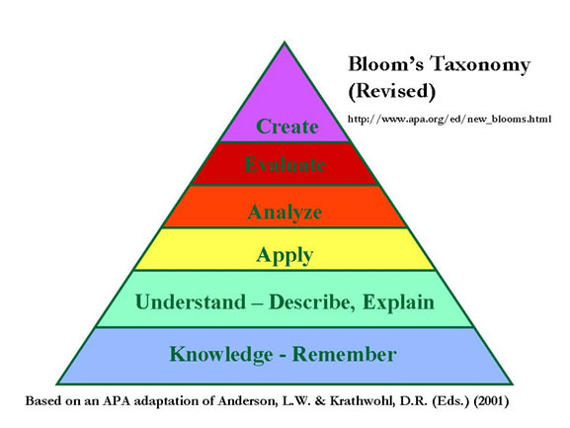
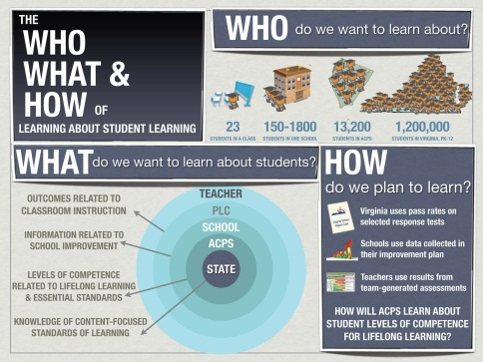
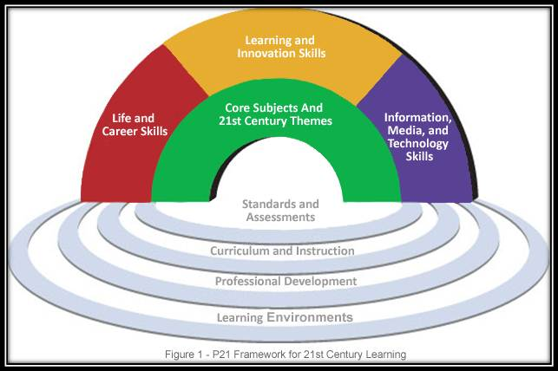
Rigor: Increased challenge of content
What students will know, understand, and be able to do
Thinking Skills
Rigor of curriculum
Quality Learning Experience for one learner
Relevance of content
Quality Assessments
Relationships to learning resources
21st Century Learning
Notes:
What does a strong rigorous curriculum look like? We want to ensure a strong rigorous curriculum includes Critical thinking, a quality balanced assessment model (performance assessments and tasks), Lifelong-Learner or 21st Century Skills. We don’t need more curriculum. The challenge with Rigor is to increase the interest and challenge for students.

Slide 11
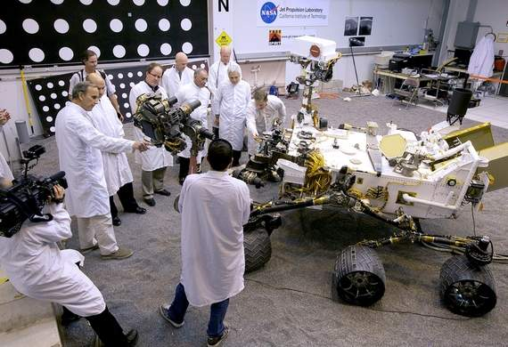
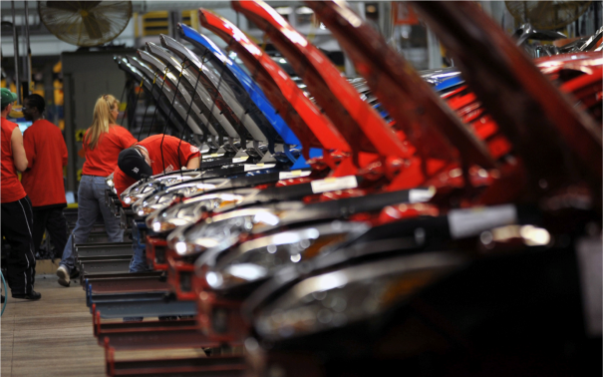
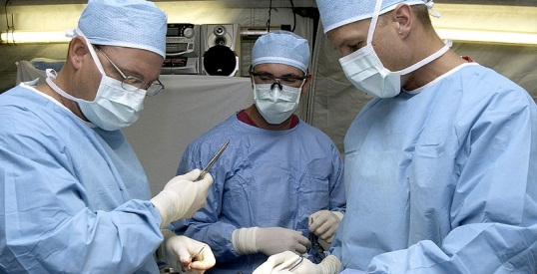
Relevance: Increased relevance of content
Rigor of curriculum
Quality Learning Experience for one learner
NASA Engineers
Why students will learn this content
Relevance of content
Ford Motor Company
Relationships to learning resources
Doctors
Notes:
The world in which our students will live changes almost daily. Our curriculum must be relevant to that world. Whether our students will work on an assembly line such as Ford Motor Company, be a NASA Engineer, or Doctor, they will all need the skills necessary to compete and survive.

Slide 12

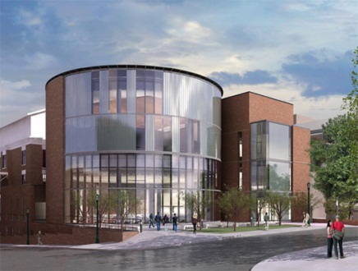
Relationships: Increased availability of resources
“It is essential that teachers first establish a close, trusting relationship with students.” – Framework for Quality Learning
Rigor of curriculum
Quality Learning Experience for one learner
Learning Technologies
Relevance of content
Relationships to learning resources
What students will use to
learn (as well as when, where, and with whom)
Learning Spaces
Notes:
The quote at the top of the slide comes from the Framework for Quality Learning. As we continue to discuss Quality Learning Experiences and look deeper into the idea of relationships, we will find that it means more than a close, trusting relationship with students. Relationships also includes What students will use to learn as well as when, where, and with whom. In a time when we are looking more closely at learning style, personalized learning, more availability of learning tools, learning spaces, student choice, relationships has become an even bigger part of the equation in providing quality learning experiences for all students.

Slide 13
Tonight’s Work Sessions
Session 1: Science – Shifting spaces, tools, and pedagogy to change learning
Session 2: Library & Literacy – Shifting spaces for students to go and connect, search, and communicate
Session 3: Universal Design for Learning – Two way information tools – ways for students to get information “in and out”

Slide 14
Breakout Sessions
Session 1 - Science
(COB 320)
Carrie Taylor & Michelle Karpovich (Western)
Session 2 – Library and Literacy
(COB 241)
Lin Hill (Jouett)
Jeremy Dove (Monticello)
Jeff Prillaman (Albemarle-MESA)
Kristie Obrecht (Yancey)
Session 3 – Universal Design for Learning
(COB 246)
Kevin Kirst (Special Education)
Andy Wojcik (Albemarle)
Andy Johnson (Stony Point)
Brian Kayser (Walton)

Slide 15
Guiding Questions
How does changing the learning space create different ways for relationships, relevance and rigor to change?
How are student experiences changing?
With respect to relationships, how are your changes connecting students with the mission of establishing a community of learners and learning?

Slide 16
What’s Next?
Grand Challenge
“To educate ALL students with 21st Century learning skills by providing quality learning experiences in EVERY classroom.”
Grant Opportunity for Schools
Purpose
Quality Learning
Professional Development
Notes:
The next iteration of

